Slide 1
What is Machine Learning & AI?
...and why is it important?
1

Slide 2


AI: Hype or Reality?
AI is one of the most important things humanity is working on. It is more profound than electricity or ﬁre.
Sundar Pichai, Google’s CEO
1

Slide 3
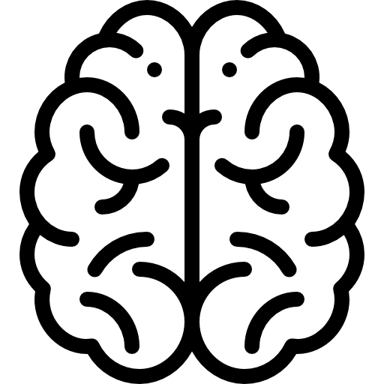

Human Intelligence
Artiﬁcial Intelligence
The ability for machines to simulate & enhance (human) intelligence
Solve problems
Achieve goals
Analyze & reason
Communicate, collaborate & inﬂuence
Consciousness,
Emotions, Intuition, Imagination
1

Slide 4

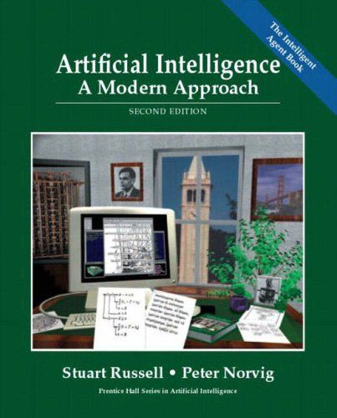
AI Deﬁnition: Academic
The designing and building of intelligent agents that receive precepts from the environment and take actions that aﬀect that environment
Stuart Russell & Peter Norvig, AI Professors
4

Slide 5
Machine Learning (ML) is a subﬁeld of AI
DATA SCIENCE
ARTIFICIAL INTELLIGENCE
MACHINE LEARNING
DEEP LEARNING
4

Slide 6
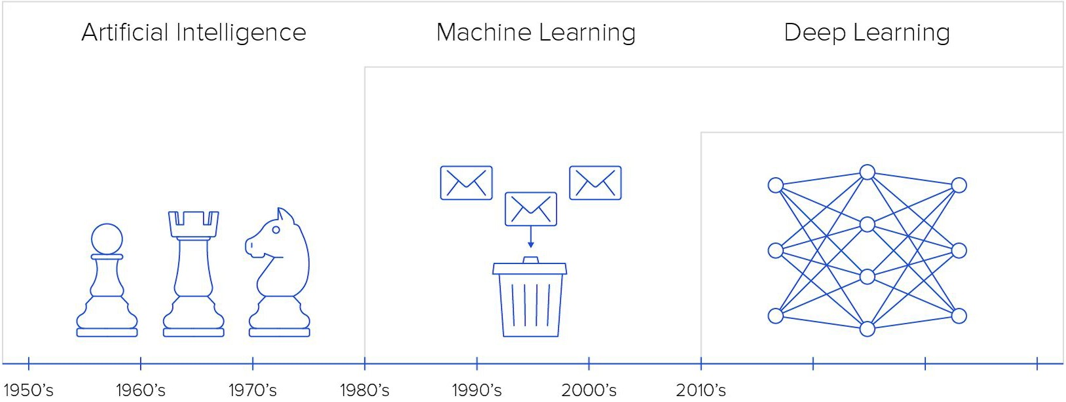
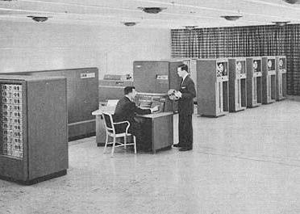
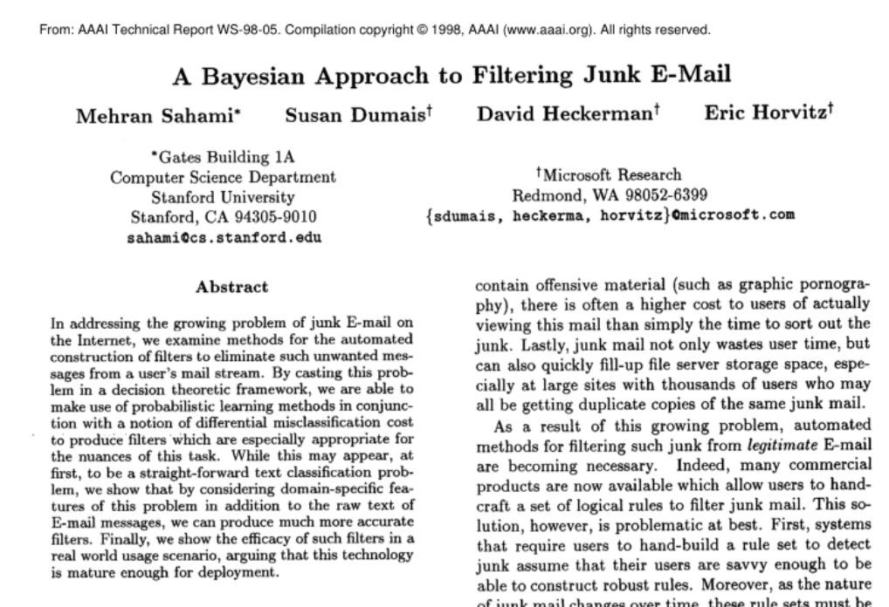
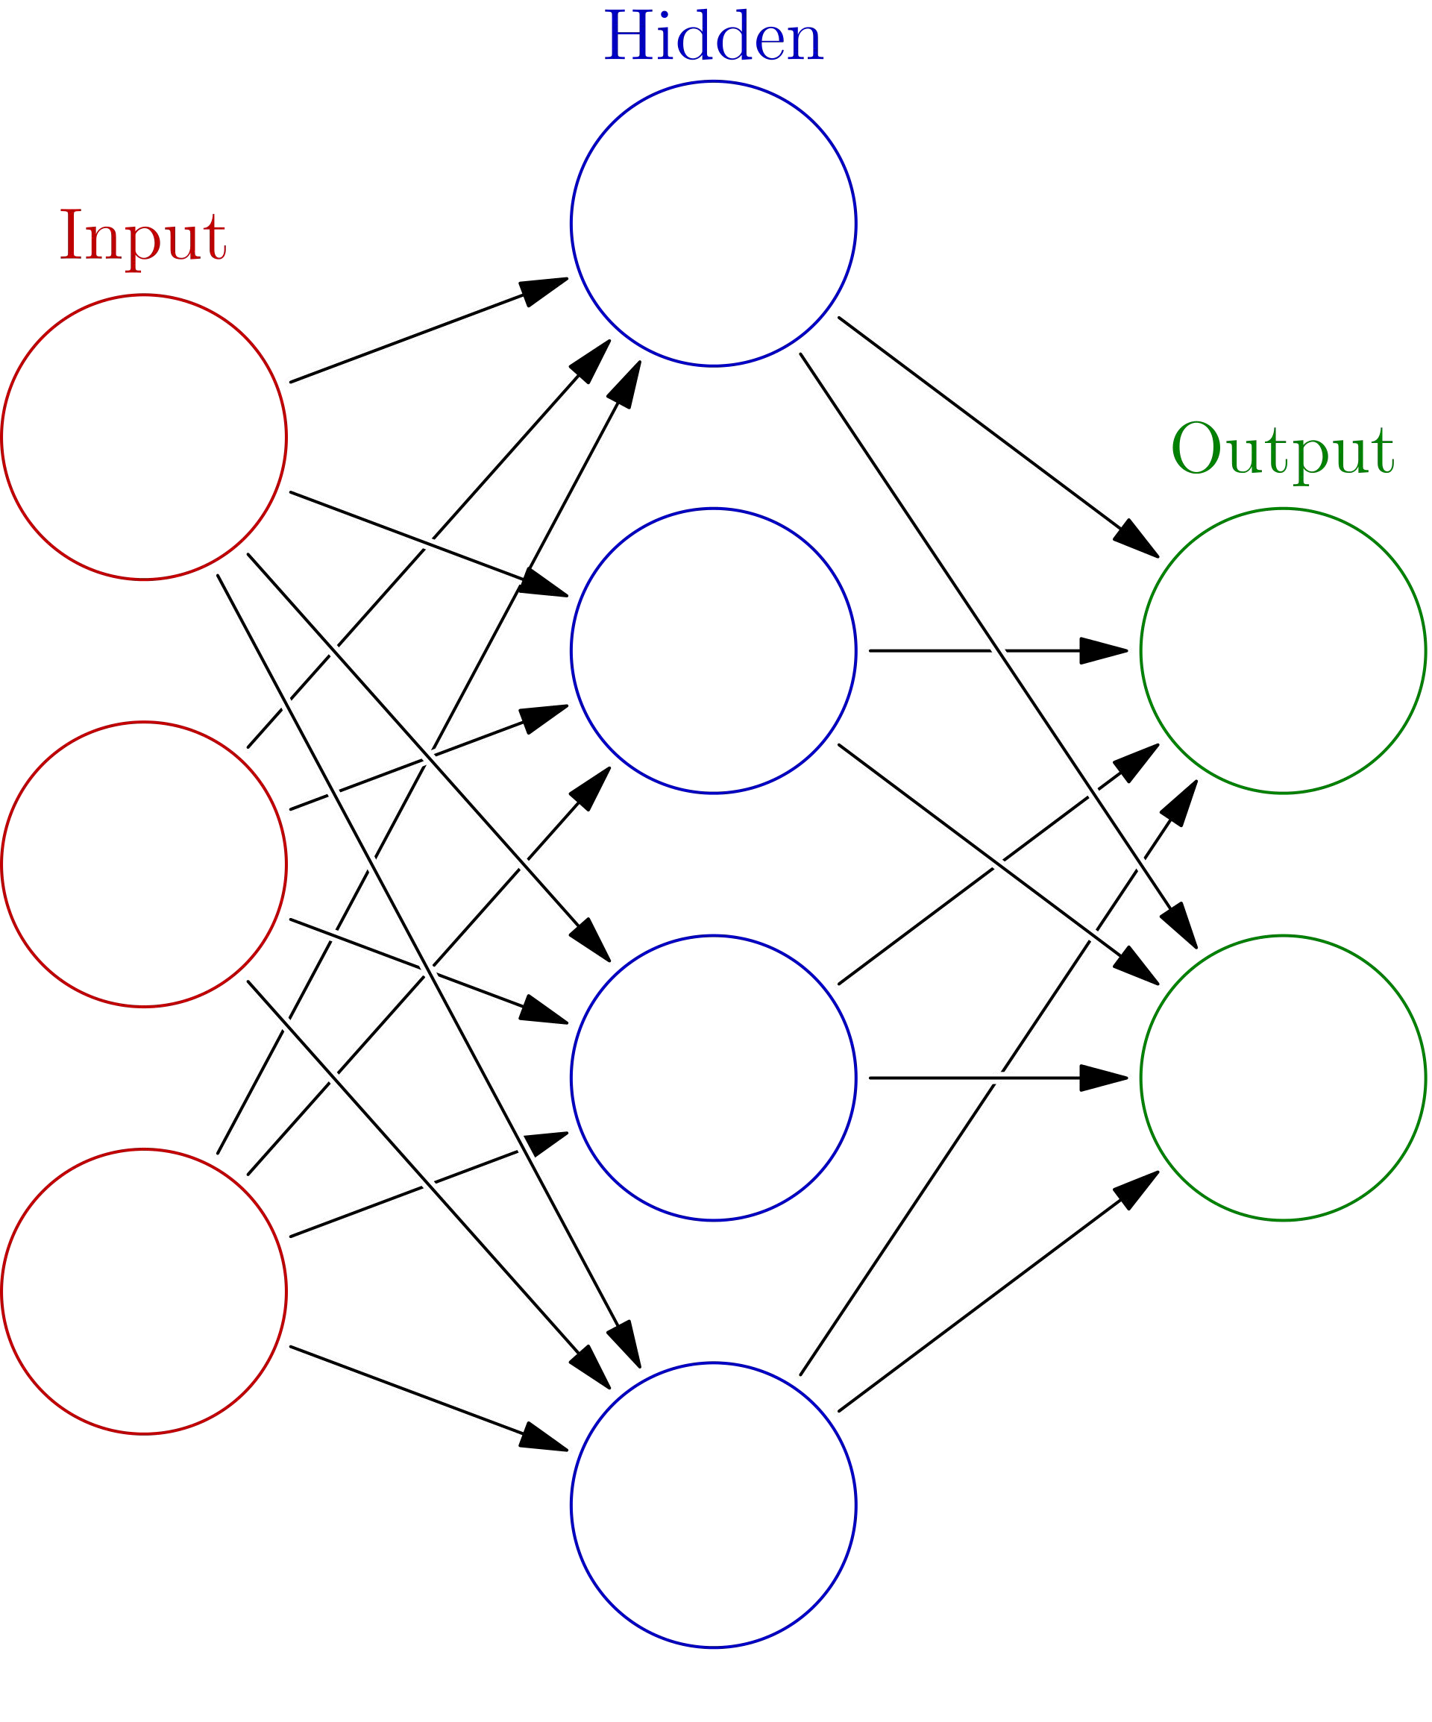
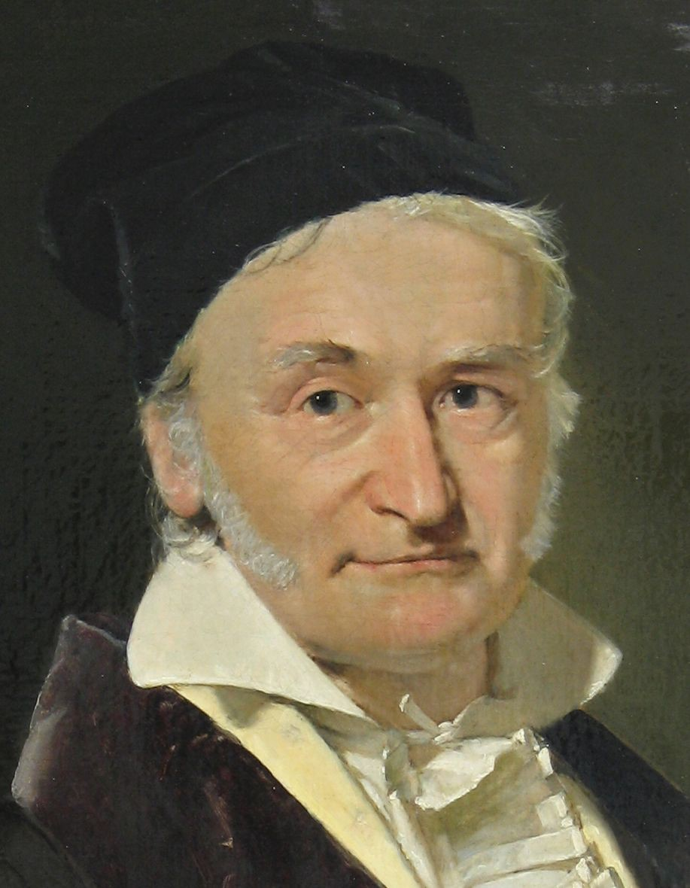

AI is not new, it’s been around for a loong time
Mathematical Statistics
1700’s
Today
Future
1943 – The first ANN
1969 – Backpropagation
2012 – AlexNet wins ImageNet
1955 – Official term and academic recognition
1985 – Rediscovery of Backprop
2013 - Today: Deep Learning is applied almost everywhere!
1958 – Rosenblatt’s Perceptron
1996 – Chess victories – defeating the world champion
6

Slide 7




What is diﬀerent this time? - 4 key enablers
1
2
3
4
Data availability
Computational power
Algorithm advancements
Broad public interest

Slide 8

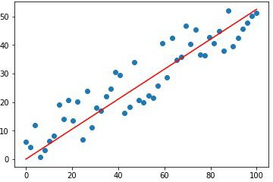
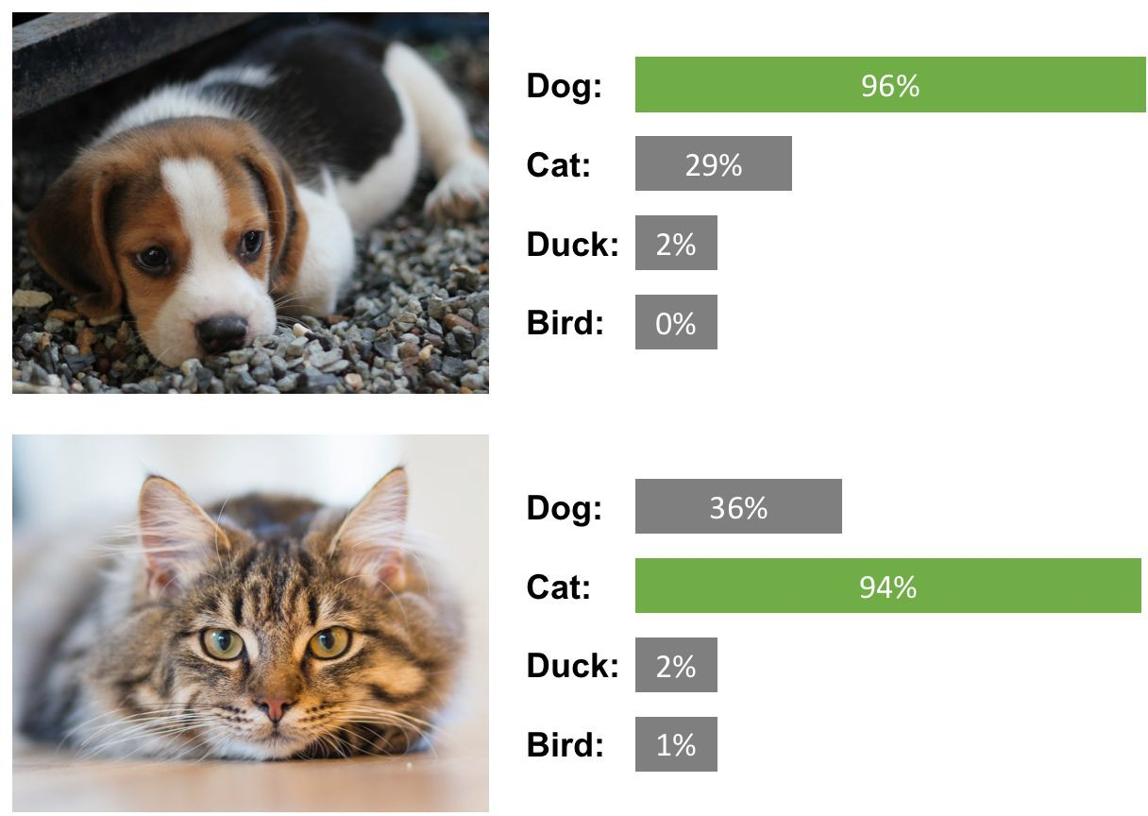
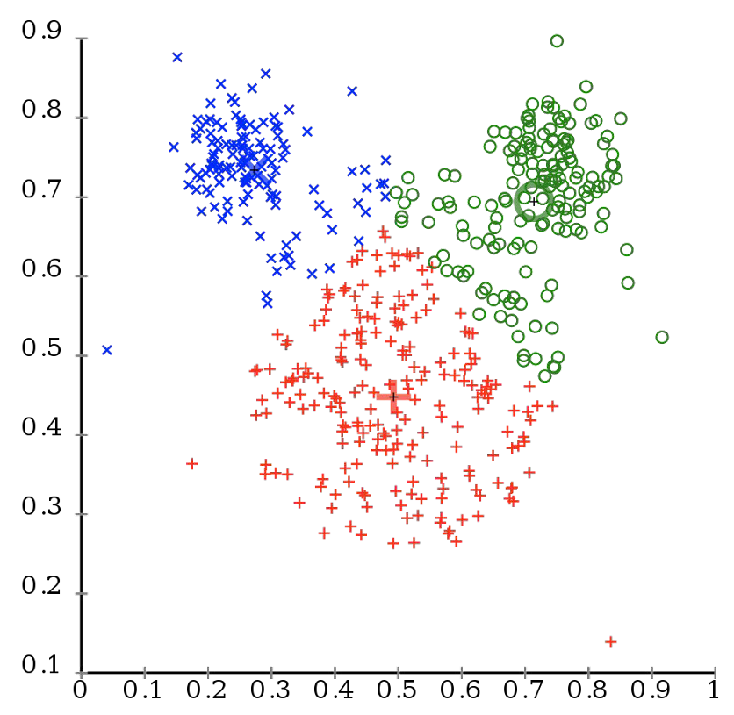

The Categories of Machine Learning
Machine Learning
Supervised learning
Unsupervised learning
+ Reinforcement Learning
Regression
Classiﬁcation
Clustering, Segmentation etc
3%
1%
4%
1%

Slide 9
Traditional algorithms rely on rules deﬁned by humans
Rules
Traditional algorithms
Answers
1
Data

Slide 10
Machine learning algorithms extract rules from data
Training phase
Answers
Rules
Machine learning
2
Data
Inference phase
Data
Rules
Predictions

Slide 11
Thank You!

